Slide 1

UE18CS390A – Capstone Project Phase – 1
Project Progress Review #2
(Project Requirements Specification and Literature Survey)
Project Title : Visual Question Answering on Statistical Plots
Project ID : PW22MHR02
Project Guide : Dr. Mamatha H.R.
Project Team : Sneha Jayaraman PES1201802825
Sooryanath I T PES1201802827
Himanshu Jain PES1201802828

Slide 2
Abstract and Scope
The aim of the project is to build a Visual Question Answering system which accepts statistical plots along with questions on the plot with respect to the elements of the plot (such as intersection of the curves, area under the curve, median value and few other varieties of such relational queries) and provides answers to the questions posed.
The system should discover relationships between elements of a plot and provide relational reasoning to answer questions on the plot.
The most important benefit is that visual question answering models on charts will help data analysts question and reason plots on a large scale, and automate the decision-making capabilities in several sectors such as the financial sector.
Notes:
Provide a basic introduction of the Project and also an overview of the scope it entails.

Slide 3
Suggestions from Review - 1
Data for the model
Type of charts we will be addressing
Bar Charts, Pie Charts and Line Charts
Real-Time Data for testing sources
Open ended questions or yes/no questions
Domain of the project
Financial Domain, Educational Domain
Domain is unrestricted and depends on the type of charts selected
Notes:
Provide the suggestions and remarks given by the panel members.
Mention the feasibility on the same showing the progress.

Slide 4
Constraints / Risks
Limitations:
The system will not be able to answer questions on the smoothness or the roughness of the plots. It can only answer relational queries – queries with respect to the other elements of the plot.
Constraints:
The project focuses on model building and providing for accurate and reliable answers to the questions posed on the statistical charts. Hence, there is less focus on the security and interoperability considerations. However, our solution will consist of an interface to the model that facilitates image upload and questions on the image.
Risks:
Operational risk in terms of management and support for the product is a possible risk case.
Notes:
Describe the issues such as legal implications, usage limitations, specific software/hardware requirements etc under dependencies.
Describe the assumptions made in your project/problem statement.
Talk about the risks that could pose obstacle to your final project delivery(technology failure or hardware failure threats or version compatibility problems).

Slide 5
Functional Requirements
Question Answering System for Charts take in statistical charts and questions related to them as input.
Visual features from the charts have to be extracted and preprocessed. This can be done using techniques like image processing and Optical Character Recognition (OCR) and visual elements detection (VED).
The questions provided as an input need to be pre-processed using NLP techniques.
Important details from the image and the questions need to be mapped and the corresponding answer should be predicted.
Deep learning methods and architectures will be employed to predict the output.
Inputs are validated by the system to recognize only statistical charts.
The results will be validated against the true answers.
The parameters for the model will be tuned to provide the most optimal answer as the output.

Slide 6
Non - Functional Requirements
Performance Requirement:
Usability : The trained model must be available at ease to use it ,just by choosing an image input from the local drive or file-system . Similar to drag and drop or attaching files. The user must be able to navigate through the interface even with minimal exposure towards computing technologies.
Reliability : As the product is developed by following practices in deep-learning , machine learning and imaging , there is no certain fixed level of reliability that can be set for the product. Reliability is not completely independent of the inputs to the model , hence reliability varies with respect to the context and type of inputs passed in.
Maintainability : As the product is just a model , maintaining the model isn’t a difficult task , it only requires a machine to reside on and a browser / interface to access.
Performance : The model is expected to draw statistical inferences based on the question and the input passed with a good and acceptable accuracy level.
Robustness : The model must be robust enough to classify any of the graph images and questions related to its scope of operation. The model must yield good performance for any input from the wide range of possible inputs pertaining to the scope of the model.

Slide 7
Non - Functional Requirements
Safety Requirement:
Safety requirements pertaining to this product are minimal as it isn’t deployed onto a live physical environment . The decision process for users , such as passing image inputs or attaching them to gain access to model /product and data must be based on the need-to-know principle, which is that access to covered data must be necessary only to the designers of the model and shouldn’t be exposed to the end users.

Slide 8
Literature Survey
Research Papers Reviewed
Answering Questions about Charts and Generating Visual Explanations
FigureNet: A Deep Learning model for Question-Answering on Scientific Plots
ChartNet: Visual Reasoning over Statistical Charts using MAC-Networks
PlotQA: Reasoning over Scientific Plots
Notes:
A critical assessment of the research that has been conducted on the topic.
4 – 5 recently published research papers/products.
Summarize the individual papers/products with as much detail as each deserves, depending up on its relative importance in the overall literature on the topic.
Minimum 4 slides on each paper/product is required.
The survey should be organized into categories.
Supporting and against the particular hypothesis.
Some alternative hypothesis.

Slide 9
Paper 1
Paper Title: Answering Questions about Charts and Generating Visual Explanations
Year of Publication: April 2020
Authors: Dae Hyun Kim, Enamul Hoque, Maneesh Agrawala
Data: https://dl.acm.org/doi/pdf/10.1145/3313831.3376467
Summary:
Paper proposed the chart question answering system that generates chart specific answers along with the explanation on how the answer was obtained. The visual attributes of the charts are transformed into references to the data. State-of-the-art ML algorithms are used to generated answers and its corresponding explanation.
Notes:
A critical assessment of the research that has been conducted on the topic.
4 – 5 recently published research papers/products.
Summarize the individual papers/products with as much detail as each deserves, depending up on its relative importance in the overall literature on the topic.
Minimum 4 slides on each paper/product is required.
The survey should be organized into categories.
Supporting and against the particular hypothesis.
Some alternative hypothesis.

Slide 10
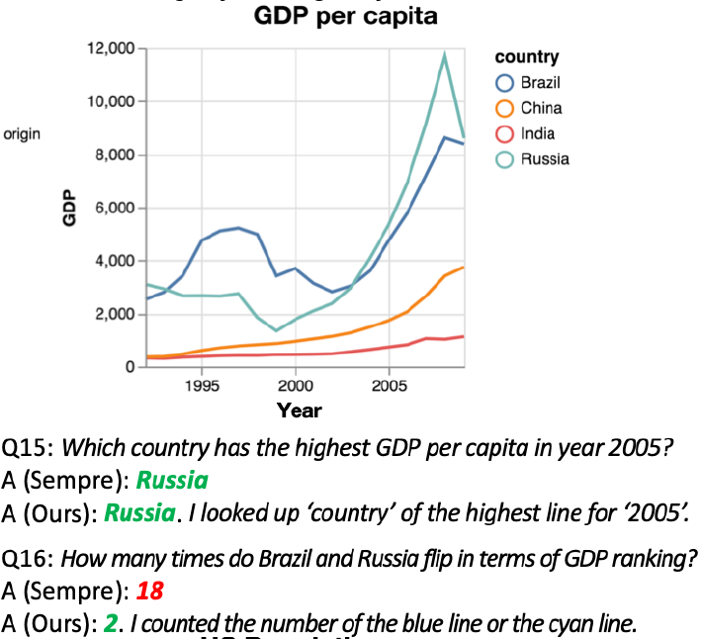
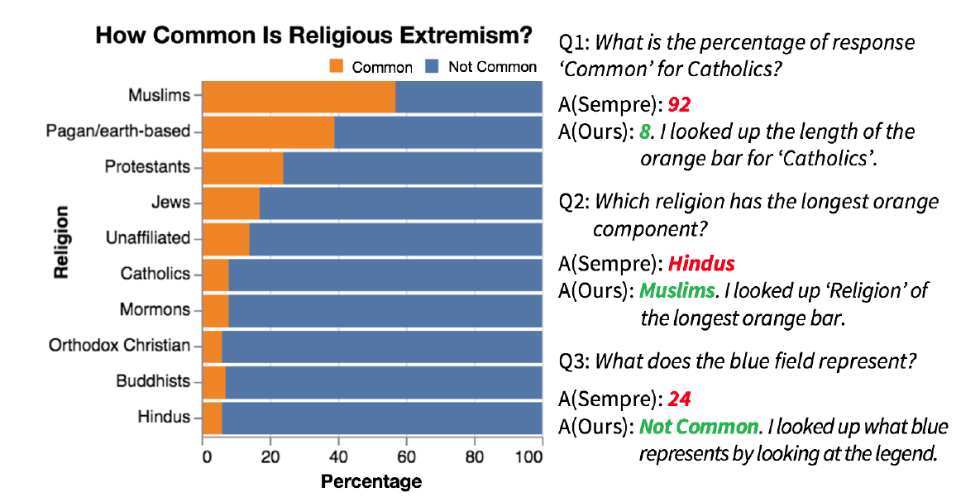
Dataset

Slide 11
Dataset
The corpus includes 52 charts, gathered from four different sources:
The Vega-Lite Example Gallery
Charts in Pew Research Reports
D3 charts that are found across the Web
Charts constructed from tables found in the WikiTableQuestions dataset
The questions, answers and their explanations were manually generated.
Dataset Counts :
In total, the corpus includes 47 bar charts (32 simple, 8 grouped, 7 stacked) and 5 line charts.
In total, 629 questions, 866 answers and 748 explanations for the 52 charts were generated.

Slide 12
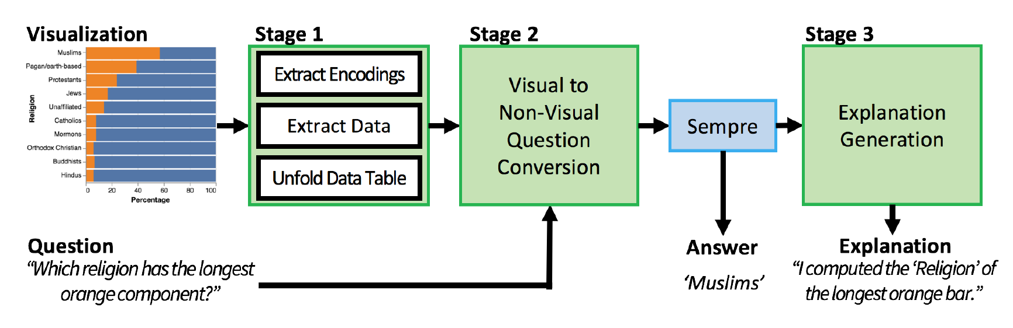
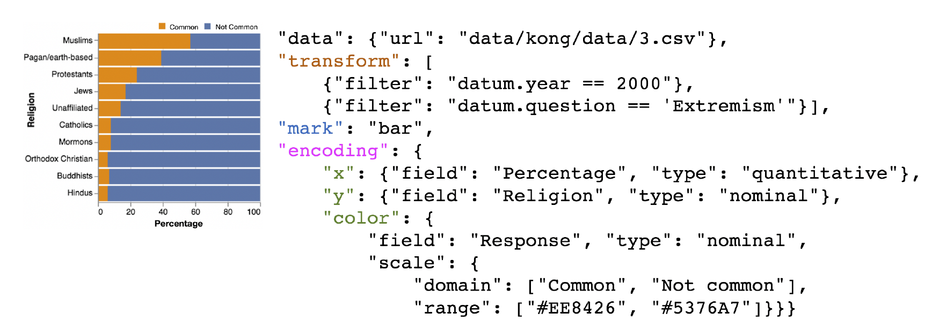
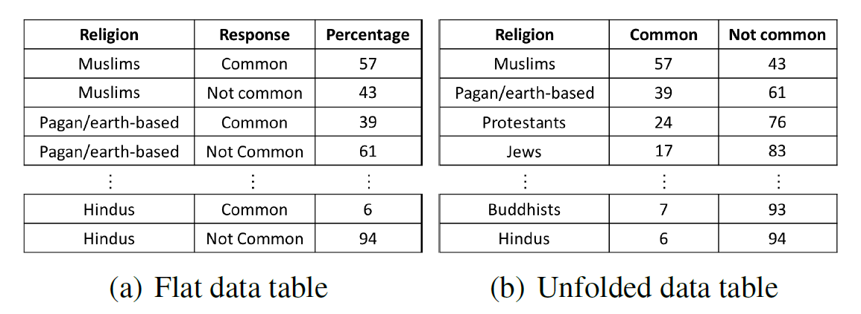
Model
Vega-Lite specification of the chart
Data extracted from the chart

Slide 13
Methodology proposed
Firstly, visual encodings like the height of the bar, color of the line, etc. are extracted from the charts.
The input question is transformed, replacing any visual references to chart elements with non-visual references to data fields and data values.
The Unfolded table, the transformed non-visual question in passed through Sempre (question answering algorithm that works with relational data tables instead of charts) to generate the answer.
Sempre converts the input natural language question into a logical query called a lambda expression, and then executes the query on the data table to generate the answer.
Finally, we convert the lambda expression from Sempre into a visual explanation for the answer, using template-based translation.

Slide 14
Methodology proposed
Formal Steps Stated in the paper
Stage 1: Extract Data Table and Encodings
Stage 2: Visual to Non-Visual Question Conversion
Step 1: Mark detection
Step 2: Dependency parsing
Step 3: Visual attribute detection
Step 4: Visual operation detection
Step 5: Apply encodings
Step 6: Natural language conversion
Stage 3: Explanation Generation
Step 1: Natural language conversion
Step 2: Implicit field recovery
Step 3: Redundancy Cleanup
Step 4: Sentence Completion
Step 5: Encoding application

Slide 15
Merits and Demerits of the proposed method in the paper
Merits
The paper not only provides accurate answers to the questions but also provides an explanation on how the answer was obtained
The system generates correct answers and explanations for many questions that Sempre cannot answer correctly
Demerits
The system cannot handle certain types of questions that involve synonyms of the features present in the chart
Improving the explanation provided for the answers

Slide 16
Paper 2
Paper Title: FigureNet: A Deep Learning model for Question-Answering on Scientific Plots
Year of Publication: July 2019 (2019 International Joint Conference on Neural Networks (IJCNN))
Authors: Revanth Reddy, Rahul Ramesh, Ameet Deshpande, Mitesh M. Kapra
Data: https://arxiv.org/pdf/1806.04655
Summary: Use of CNN with depth-wise convolutions, LSTM and feed-forward NN to handle the task of visual question answering on bar plots and pie charts on the FigureQA dataset.
Notes:
A critical assessment of the research that has been conducted on the topic.
4 – 5 recently published research papers/products.
Summarize the individual papers/products with as much detail as each deserves, depending up on its relative importance in the overall literature on the topic.
Minimum 4 slides on each paper/product is required.
The survey should be organized into categories.
Supporting and against the particular hypothesis.
Some alternative hypothesis.

Slide 17
Model
The FigureNet architecture as proposed, can handle the task of relational question answering on Bar Plots and Pie charts. It uses the FigureQA dataset, that consists of statistical plots with plot elements that are color coded. Additionally, it is guaranteed that the plot consists of no more than 11 plot elements, and that there are 100 different colors that are used to represent plot elements.
The end goal of the FigureNet model is to be able to answer to questions in a binary yes/no manner. To be able to do this, the authors have divided the task into subtasks as follows.
Spectral Segregator Module - Identify plot elements and color of the plot elements
Order Extraction Module - Identify and quantify the statistical values of each plot element, followed by sorting of these values into a linear order.
Question Encoding
Question Color encoding

Slide 18
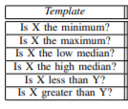
Dataset
FigureQA
FigureQA is a visual reasoning corpus which contains over a million question-answer pairs which are grounded in scientific style figures. This synthetic corpus has been designed to focus specifically on reasoning.
FigureQA also has the advantage of not requiring text identification modules like OCR, since plot elements are colour-coded.
It follows the general Visual Question answering setup, but also provides annotated data with bounding boxes for each figure.
100 unique colours covering the entire spectrum of colours, were chosen from the X11 named colour set.
FigureQA’s training, validation and test sets are constructed such that all 100 colours are seen during training.

Slide 19
Methodology proposed
Spectral Segregator Module:
Identify plot elements and color of the plot elements
128 x 128 x 3 image is passed as input to a CNN that uses depth-wise convolutions to identify colors and separate channel information. This way we don’t just get an aggregate map of the image. The output here is a 512 dimensional image representation.
This image representation is passed to a 2-layer LSTM to get a probability distribution across the 100 images and an additional STOP label(used for no plot element)
Order Extraction Module:
Identify and quantify the statistical values of each plot element and their relative order
Similar to that of the previous module expect that now the output of the LSTM will be the ordering for each of the plot elements starting from 1.
Question Encoding and Question Color encoding:
Uses LSTM
Final feed-forward NN:
All the four modules are concatenated and passed onto a feed forward NN to produce a binary (Yes/No) answer ( using Sigmoid Activation)

Slide 20
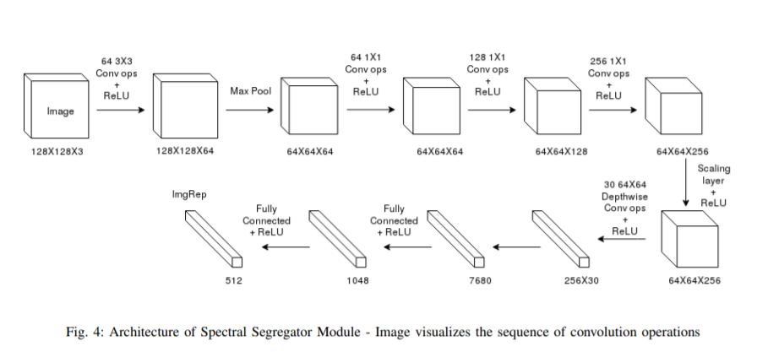
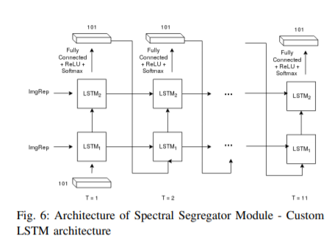
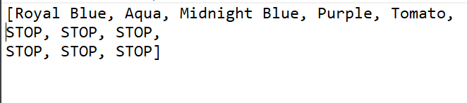
Sample Output

Slide 21
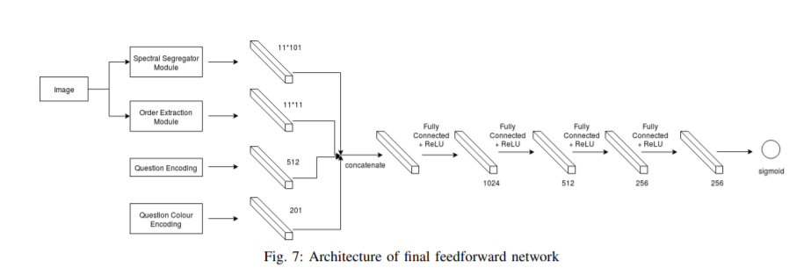
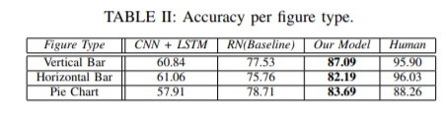
Results

Slide 22
Merits and Demerits of the proposed method in the paper
Merits:
The model performs significantly better than the baseline models.
This is because the architecture doesn’t use the traditional CNN, instead uses depthwise convolutions
Lesser training time as articulated in the paper
Demerits
The model works on only bar plots and pie charts
It is capable of only binary reasoning, and not capable of answering open-ended questions
It makes use of the FigureQA dataset, thereby making use of the property of the charts being color coded.

Slide 23
Paper 3
Paper Title: ChartNet: Visual Reasoning over Statistical Charts using MAC-Networks
Year of Publication: July 2019
Authors: Monika Sharmaa, Shikha Guptab, Arindam Chowdhurya, Lovekesh Vig
Data : https://arxiv.org/pdf/1911.09375.pdf
Summary:
The paper solves the problem of reasoning over statistical charts (only bar charts and pie charts) using MAC-Network (Memory, Attention, and Composition). The model is capable of answering open-ended questions and gives chart-specific answers. The classification layer of MAC is replaced by the regression layer and constructs a bounding box around the text of the answer. OCR is used to read the text and display the answer.
Notes:
A critical assessment of the research that has been conducted on the topic.
4 – 5 recently published research papers/products.
Summarize the individual papers/products with as much detail as each deserves, depending up on its relative importance in the overall literature on the topic.
Minimum 4 slides on each paper/product is required.
The survey should be organized into categories.
Supporting and against the particular hypothesis.
Some alternative hypothesis.

Slide 24
Dataset
Dataset of bar-charts and pie-charts was made.
The bar charts dataset consists of vertical bars and was created by varying the height and number of colors of bars
Dataset for pie-charts was created by varying the angles and colors of sectors.
Bounding box annotations of textual content present over the chart images was saved to give chart specific answers
Total number of image question pair examples for training, validation and testing are 20000, 5000 and 5000 respectively for each dataset ( i.e., bar and pie charts).

Slide 25
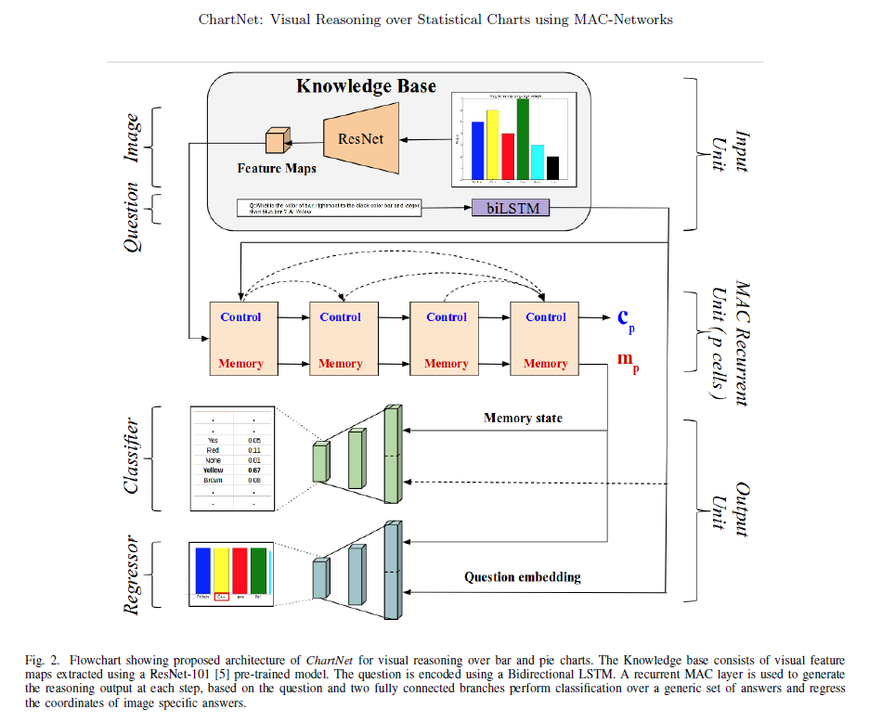
Model

Slide 26
Methodology proposed
ChartNet network consists of three layers:
Input unit
MAC Cell
Output unit
Input Unit
Bar or pie chart is given as input and corresponding question
Features from the images are extracted using ResNet101 deep CNN architecture
Knowledge base is defined to represent the height and width of the processed image
Question is converted into a word embedding and further processed by biLSTM
MAC Cell
Recurrent unit which consists of three components : Control, Read and Write
Defined to learn fundamental reasoning operations and implement them
Output Unit
This unit consists of two networks : Classifier and Regressor
Classifier network predicts a probability distribution over the pre-defined set of generic answers through a softmax normalization
Regressor network is used to provide chart-specific answers

Slide 27
Merits and Demerits of the proposed method in the paper
Merits
Automated method for question answering over open-ended questions
MAC-Network appended with a regression layer helps the model make prediction over unseen answers
Demerits
The model is not generic and works only for vertical bar charts and pie charts
Model cannot answer questions that require numerical operations

Slide 28
Paper 4
Paper Title: “PlotQA: Reasoning over Scientific Plots”
Year of Publication: 2020
Authors: Nitesh Methani , Pritha Ganguly,
Mitesh M.Khapra and Pratyush Kumar.
Data: PlotQA : Link to Official Paper Work
Summary:
A step towards developing a holistic plot based visual question answering model , which can handle both in vocabulary and open ended queries using a hybrid approach.
Notes:
A critical assessment of the research that has been conducted on the topic.
4 – 5 recently published research papers/products.
Summarize the individual papers/products with as much detail as each deserves, depending up on its relative importance in the overall literature on the topic.
Minimum 4 slides on each paper/product is required.
The survey should be organized into categories.
Supporting and against the particular hypothesis.
Some alternative hypothesis.

Slide 29
Model
Existing Works :
Existing models for VQA are of two types: (i) read the answer from the image (as in LoRRA) or (ii) pick the answer from a fixed vocabulary (as in SAN and BAN). Such models work well for datasets such as DVQA where indeed all answers come from a fixed vocabulary (global or plot specific) but are not suited for PlotQA with a large number of OOV questions.
Plot QA’s Model :
This is a hybrid model containing the following elements:
(i) a binary classifier for deciding whether the given question can be answered from a small fixed vocabulary or needs more complex reasoning,.
(ii) a simpler QA-as-classification model to answer questions of the former type.
(iii) a multi-staged model containing four components as described below <in the next slide> to deal with complex reasoning questions.

Slide 30
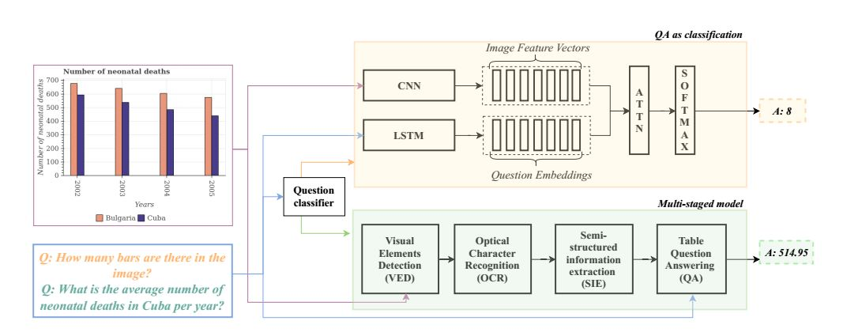
Model
The final stage of the pipeline is to answer questions on the semi-structured table. As this is similar to answering questions from the WikiTableQuestions dataset , this work adopts the same methodology .
Some of the visual elements such as title, legends, tick labels, etc. contain numeric and textual data. For extracting this data from within these bounding boxes, we use a stateof-the-art OCR model.
The first task is to extract all these visual elements by drawing bounding boxes around them and classifying them into the appropriate class.
The next stage of extracting the data into a semistructured table.
.

Slide 31
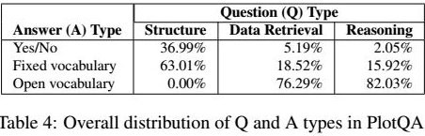
Dataset
dataset :The plots are generated from data sourced from World Bank, government sites, etc., thereby having a large vocabulary of axis and tick labels, and a wide range in data values. The questions are complex as they are generated based on 74 templates extracted from 7,000 crowd-sourced questions asked by workers on a sampled set of 1,400 plots.
Summary about the Dataset
Dissection of the dataset

Slide 32
Methodology proposed
This is a hybrid model containing the following elements: (i) a binary classifier for deciding whether the given question can be answered from a small fixed vocabulary or needs more complex reasoning, and (ii) a simpler QA-as-classification model to answer questions of the former type, and (iii) a multi-staged model containing four components as described below to deal with complex reasoning questions.
1. Visual Elements Detection (VED)
The first task is to extract all these visual elements by drawing bounding boxes around them and classifying them into the appropriate class.
Upon comparing all methods, it is found that Faster R-CNN model along with Feature Pyramid Network(FPN) performed the best and hence we used it as our VED module.
2. Object Character Recognition (OCR):
Some of the visual elements such as title, legends, tick labels, etc. contain numeric and textual data. For extracting this data from within these bounding boxes, the state of-the-art OCR model is used.
3. Semi-Structured Information Extraction (SIE)
4. Table Question Answering (QA)
The final stage of the pipeline is to answer questions on the semi-structured table. As this is similar to answering questions from the WikiTableQuestions dataset , we adopt the same methodology ..

Slide 33
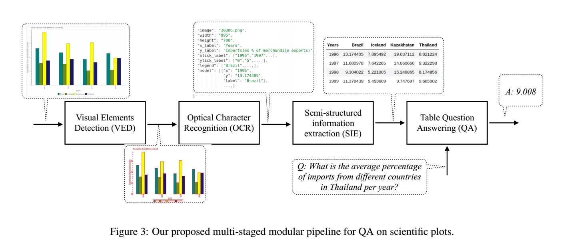
Methodology proposed

Slide 34
Merits and Demerits of the proposed method in the paper
Merits
Can handle out of the vocabulary questions (OOV) along with in-vocabulary question types.
The data collected to prepare graphs in the dataset are from various financial and business resources.
Reduces the gap between existing synthetic plot datasets and real-world plots and question templates.
Demerits
The model is not generic and works only for bar charts , line charts and dot plots.
There exists a need for more accurate visual element detection (VED) module to improve reasoning over plots.

Slide 35
Summary of Literature Survey
 | Paper 1 | Paper 2 | Paper 3 | Paper 4
Paper Title | Answering Questions about Charts and Generating Visual Explanations | FigureNet: A Deep Learning model for Question-Answering on Scientific Plots | ChartNet: Visual Reasoning over Statistical Charts using MAC-Networks | PlotQA:Reasoning over Scientific Plots
Similarities with other papers | Uses table based QA technique like paper 4 | Forms a part of Paper 4, answering only YES/NO questions | Similar to paper 4 - since it can answer open-ended questions | Can handle OOV questions and in -vocabulary questions.
Differences with other papers | Generates answers along with the reasoning (as to how the answer is obtained). | Uses deep learning techniques such as CNN and LSTM, can only answer binary YES/NO questions | Uses compositional models. | Uses separate pipelines for answering OOV and in-vocabulary questions.The dataset contains 80% of reasoning based QA pairs.
Use case in our project | Dataset available for bar chart and line chart can be used to train our own model | Base paper, to test out the applicability of CNN for image representation, LSTM for question encoding | Paper helps us build and understand DL architecture for open-ended questions | Paper to help analyse how to deal with open-ended questions, given such a dataset
Notes:
A conclusion should then state clearly the main conclusions of the review and give a clear explanation of their importance and relevance.
Give a glimpse of the proposed methodology.
The strengths or weaknesses in the methods of the studies reviewed should be highlighted.
Include the relevant similarities and differences between papers/products.

Slide 36
Existing Solutions
Answering Questions about Charts and Generating Visual Explanations
https://github.com/dhkim16/VisQA-release
FigureNet: A Deep Learning model for Question-Answering on Scientific Plots
https://github.com/vmichals/FigureQA-baseline
https://github.com/Maluuba/FigureQA
https://github.com/Maluuba/FigureQA/releases/tag/v0.1.0
PlotQA: Reasoning over Scientific Plots
https://github.com/NiteshMethani/PlotQA
DVQA: Understanding Data Visualizations via Question Answering
https://github.com/kushalkafle/DVQA_dataset
https://github.com/xeniaqian94/DVQA
Notes:
Provide any other information you wish to add on.
Note: Changes can be made in the template, with the consent of the guide for inclusion of any other information.

Slide 37
References
Kim, Dae Hyun, Enamul Hoque, and Maneesh Agrawala. "Answering questions about charts and generating visual explanations." Proceedings of the 2020 CHI Conference on Human Factors in Computing Systems. 2020.
Reddy, Revanth, et al. "Figurenet: A deep learning model for question-answering on scientific plots." 2019 International Joint Conference on Neural Networks (IJCNN). IEEE, 2019.
Sharma, Monika, et al. "ChartNet: Visual reasoning over statistical charts using MAC-Networks." 2019 International Joint Conference on Neural Networks (IJCNN). IEEE, 2019.
Methani, Nitesh, et al. "Plotqa: Reasoning over scientific plots." Proceedings of the IEEE/CVF Winter Conference on Applications of Computer Vision. 2020.
Notes:
Provide references pertaining to your research according to IEEE format.
Example:
G. Eason, B. Noble, and I. N. Sneddon, “On certain integrals of Lipschitz-Hankel type involving products of Bessel functions,” Phil. Trans. Roy. Soc. London, vol. A247, pp. 529–551, April 1955. (references)

Slide 38
Thank You

